Slide 1
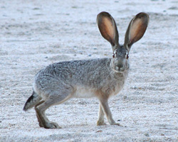
Warm Up: 2/22/2016
Think of a time you saw two different animals living in the same area. How did they benefit or harm each other?

Slide 2
Introduction to Ecology

Slide 3
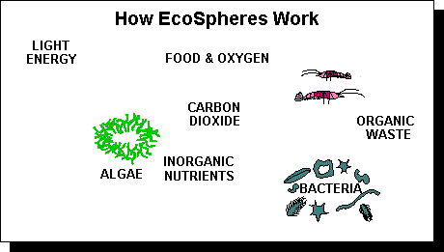

Slide 4
Discovering New Vocabulary
Use the book to find the definitions for your assigned terms
Write down the definitions on your note sheet
Be prepared to share
Write down the definitions on your note sheet as they are presented

Slide 5
What is Ecology?
The study of interactions between organisms and their environment.

Slide 6
What does abiotic mean?
Abiotic
A= not and Bio= life
Therefore “not life”
Examples include:
Sun
Water
Rocks

Slide 7
Ecological Organization

Slide 8
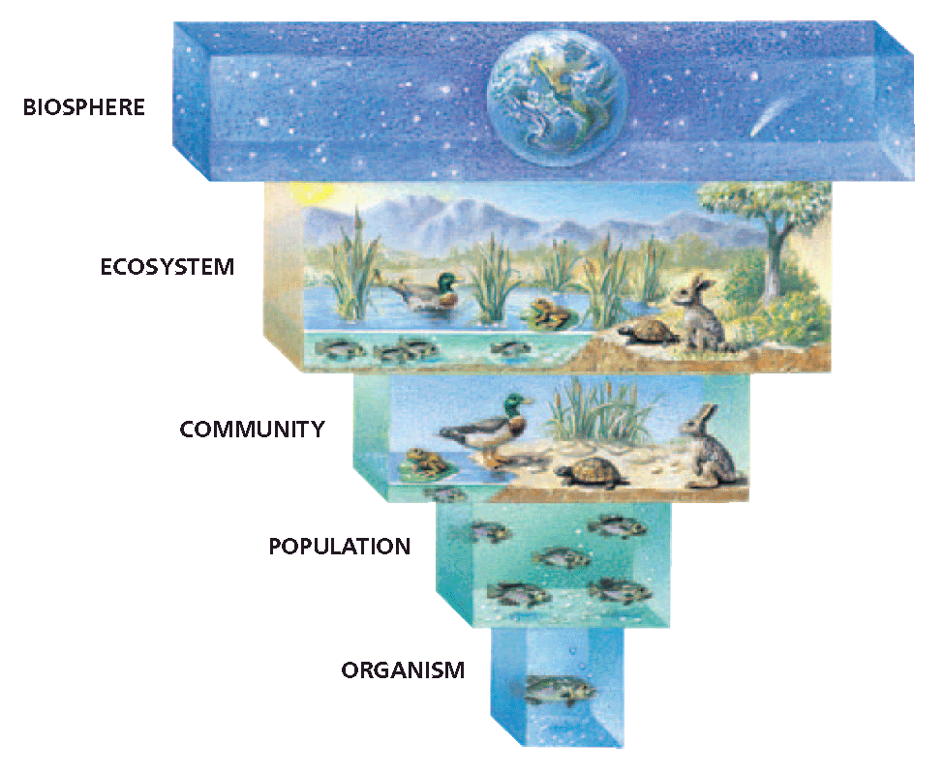

Slide 9
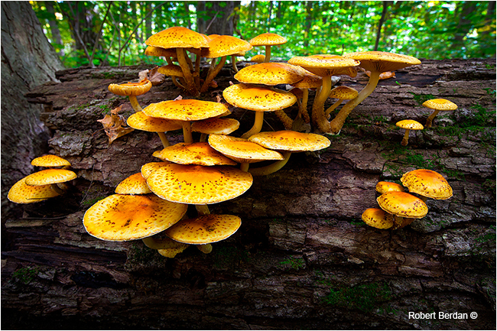
Niche vs. Habitat
A niche is an organism’s role.
A habitat is an organism’s home.
Log
Decomposer

Slide 10
What is an Autotroph?
An organism that produces its own energy
Also known as a producer
Plants

Slide 11
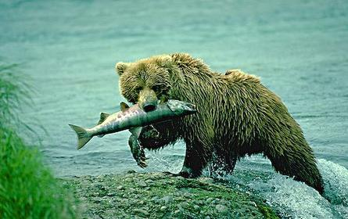
What is a Heterotroph?
An organism that cannot produce their own energy
Also known as consumers
Animals

Slide 12
Types of Heterotrophs
Carnivores - an animal that feeds on meat.
Herbivores - an animal that feeds on plants.
Omnivores - an animal that eats feeds on mean and plants.

Slide 13
Ticket Out
“What I Learned” Statement:
What did you learn about ecology today?

